Slide 1

CodePro Certification System
Muhammad Danish
Huzaifa Shahab

Slide 2

Sequence
Problem Statement
Functional Requirements
Interface
Future Prospects

Slide 3
Problem Statement
"Building a comprehensive programming assessment platform where users can take multiple tests, track their performance, and earn certificates upon meeting predefined passing criteria. The platform aims to provide an engaging and rewarding learning experience for individuals seeking to enhance their programming skills."

Slide 4


User Side
Functional Requirements
Admin Side

Slide 5
User Side
User authentication and registration system
Quiz-taking system
Performance report after each quiz
Storage of each quiz result in the database
Generation of certificate if user meets passing criteria

Slide 6
Admin Side
Admin authentication and registration system
Add/delete questions in the question bank
View user information

Slide 7
Admin Side

Slide 8
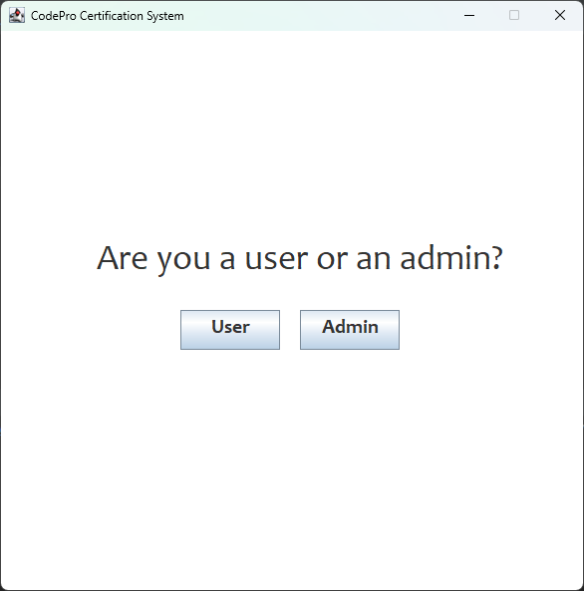
Main Menu

Slide 9
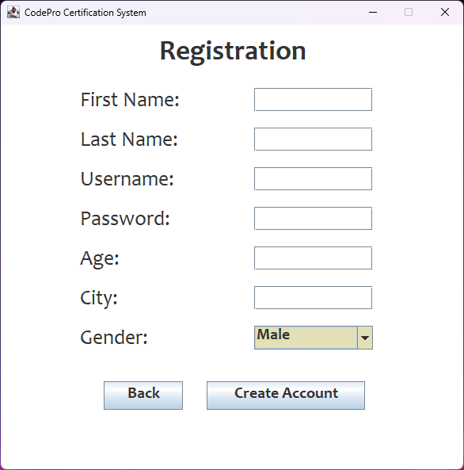
Registration

Slide 10
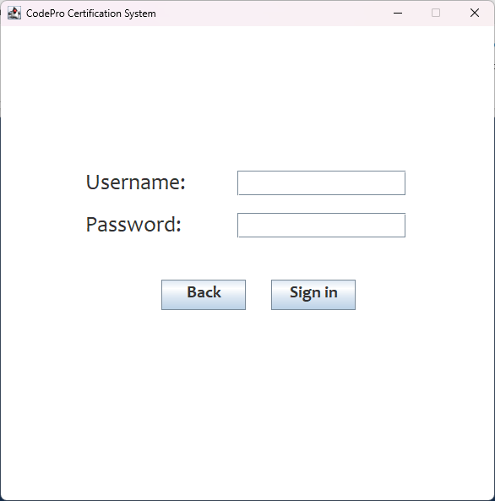
Sign-In

Slide 11
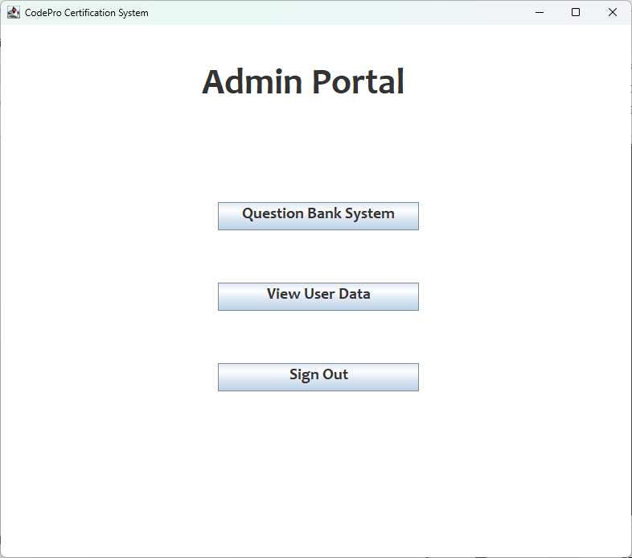
Admin Portal

Slide 12
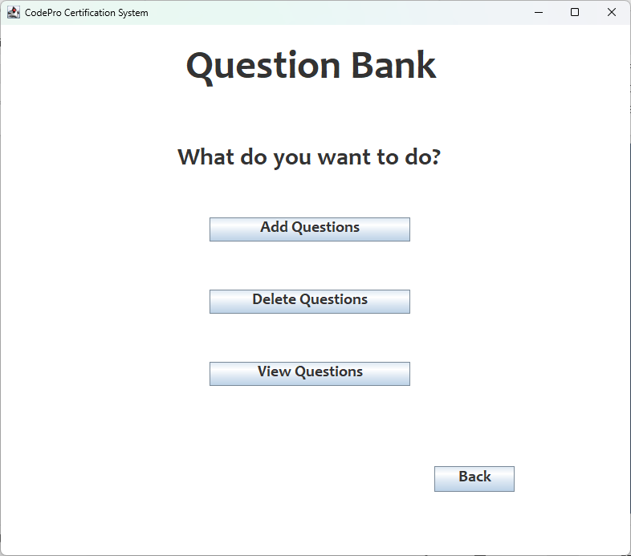
Question Bank System

Slide 13
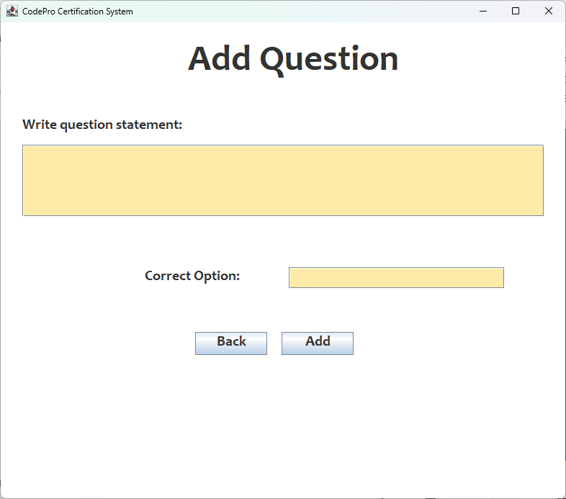
Add Questions

Slide 14
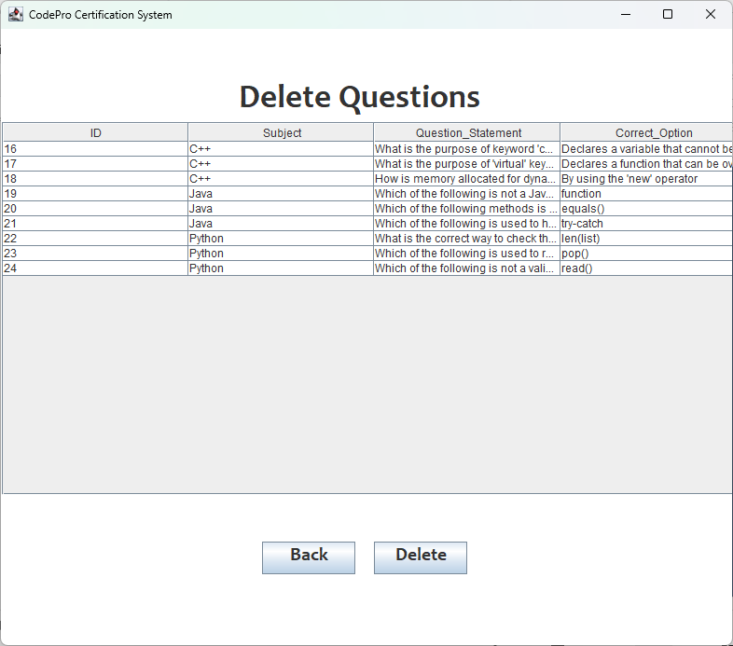
Delete Questions

Slide 15
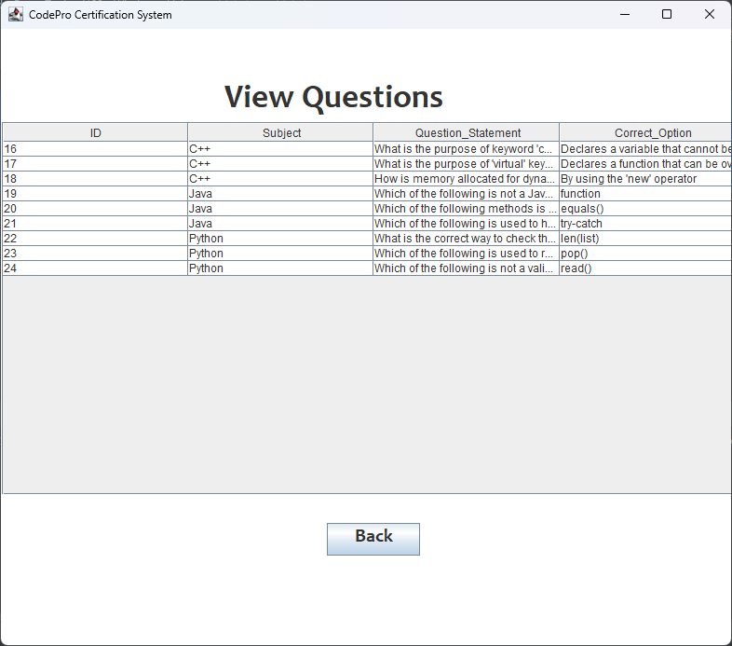
View Questions

Slide 16
Admin Portal

Slide 17
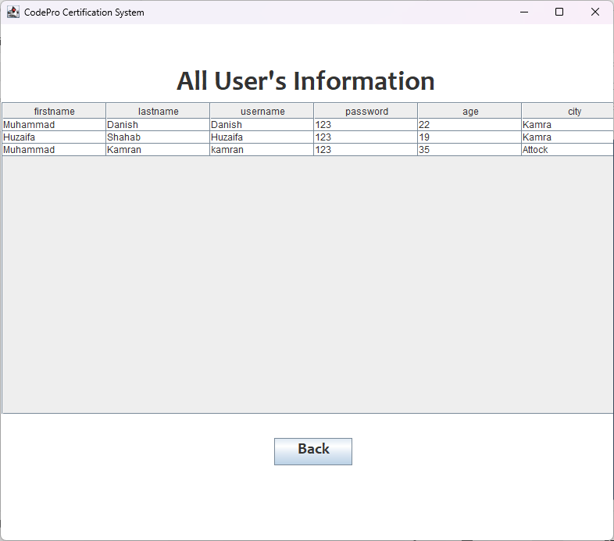
User’s Information

Slide 18
User Side

Slide 19
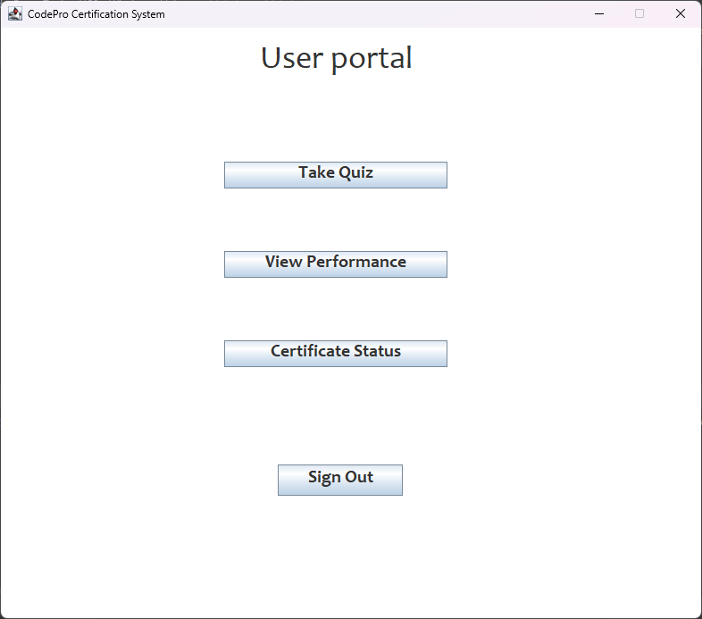
User portal

Slide 20
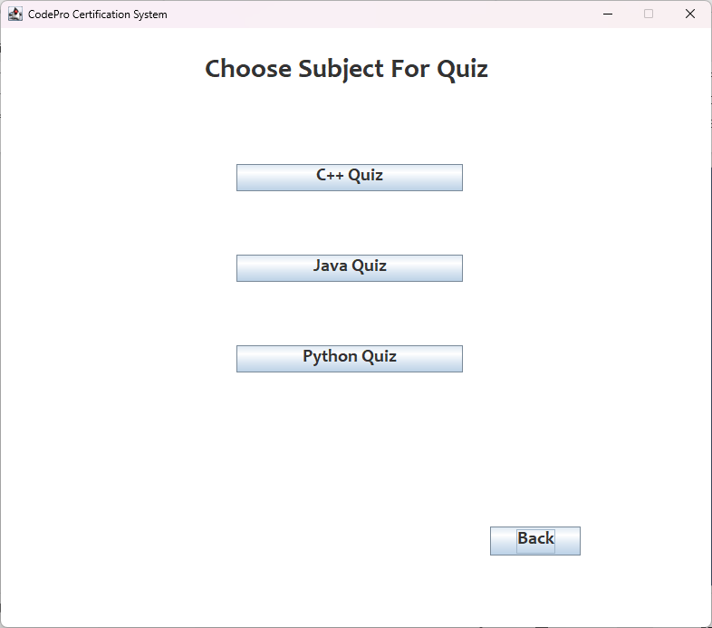
Choose Subject

Slide 21
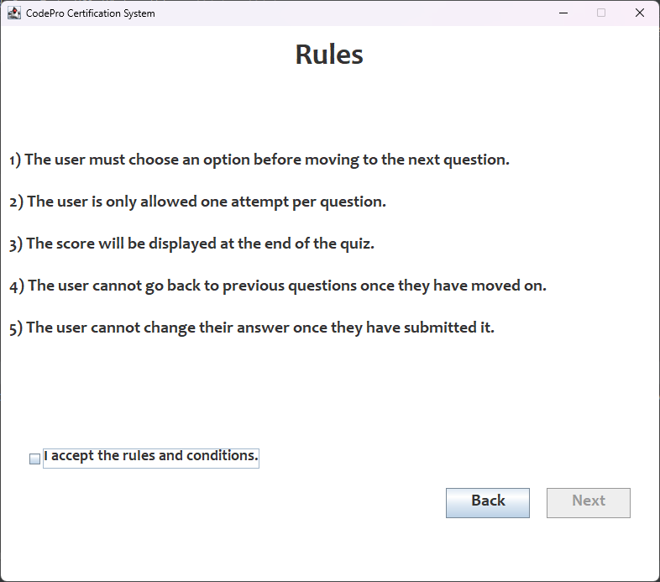
Rules

Slide 22
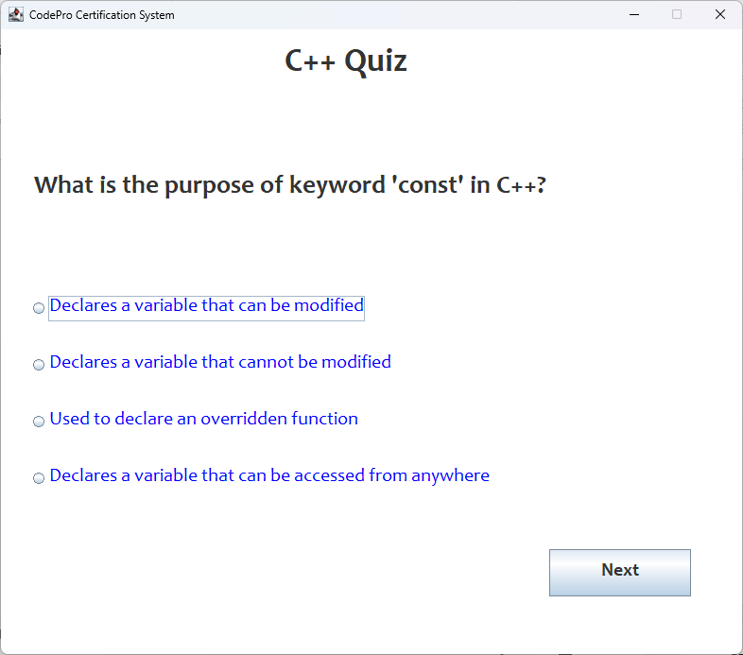
Quiz Taking System

Slide 23
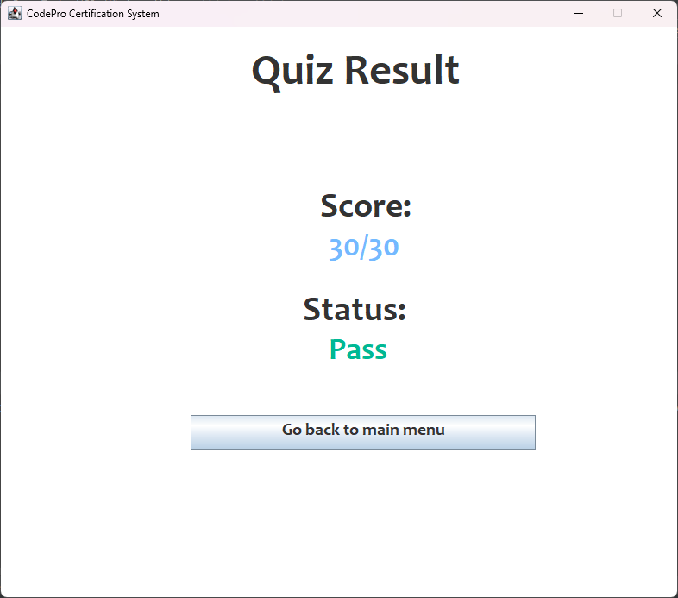
Quiz Result

Slide 24
User portal

Slide 25
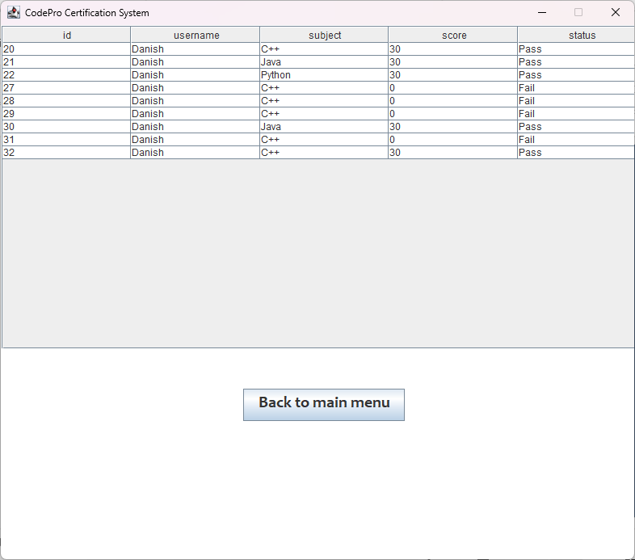
Past Performances

Slide 26
User portal

Slide 27
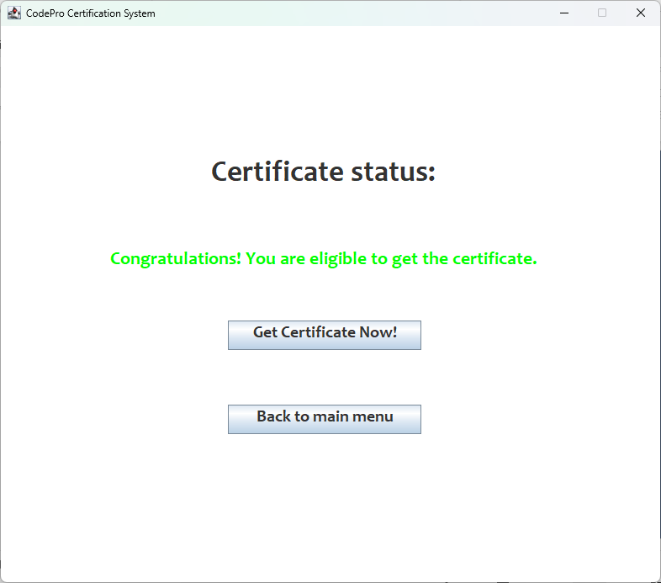
Certificate Status

Slide 28
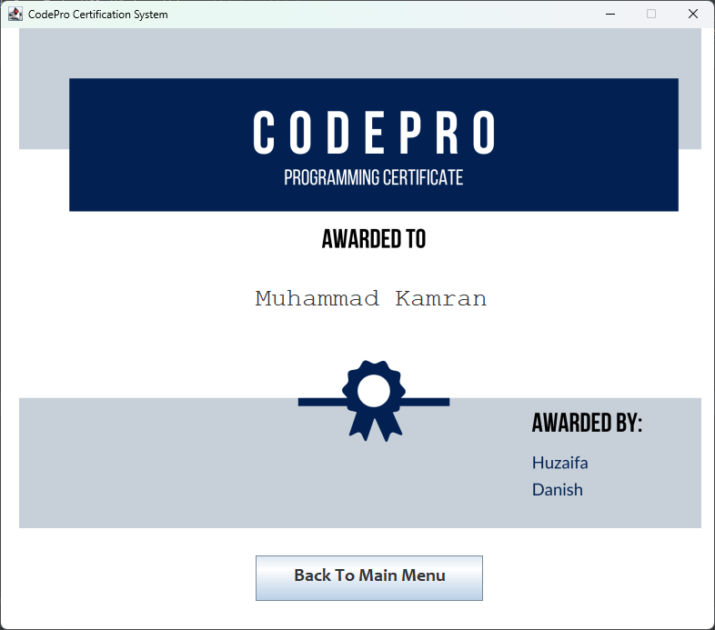
Certificate

Slide 29
Future Prospects
Leaderboard: Implement a feature to display top quiz performers, fostering healthy competition.
Social Sharing: Integrate functionality to share quiz results and certificates on multiple platforms, boosting engagement.
GUI Enhancement: Improve the user interface with visually appealing graphics and interactive elements for an engaging quiz experience.

Slide 30


Thank you!
Feel free to ask questions or give suggestions!

